Slide 1
Aviation POC
1 | Aviation Business Case & Scope
2 | Architecture
3 | Application UI workflow
4 | Application UI mock-ups

Slide 2
Business Case & Our Understanding
Client scenarios – Component Reliability UC
Problem Statement – I can’t predict when components will fail or identify rogue units in a timely manner.
“By implementing a micro-services architecture, show me how Capgemini can help me visualize, trend, identify and predict thousands of components on a fleet of aircraft?”
Scope
Build an Aircraft component performance analysis system with a near future requirement of predictive analysis of components performance.
Key deliverables:
Phase 1
Problem : “Identify rogue units in a timely manner.”
Solution : Build dynamic User Interface(UI) screens which enable the performance tracking of aircraft components, using Unit (component) based removal data.
Phase 2 :
Problem : “I can’t predict when components will fail ..!”
Solution : Predictive analysis using IoT / machine learning to predict the failure of the components that enables cost savings through increased performance and decreased maintenance cost and operational disruption.

Slide 3
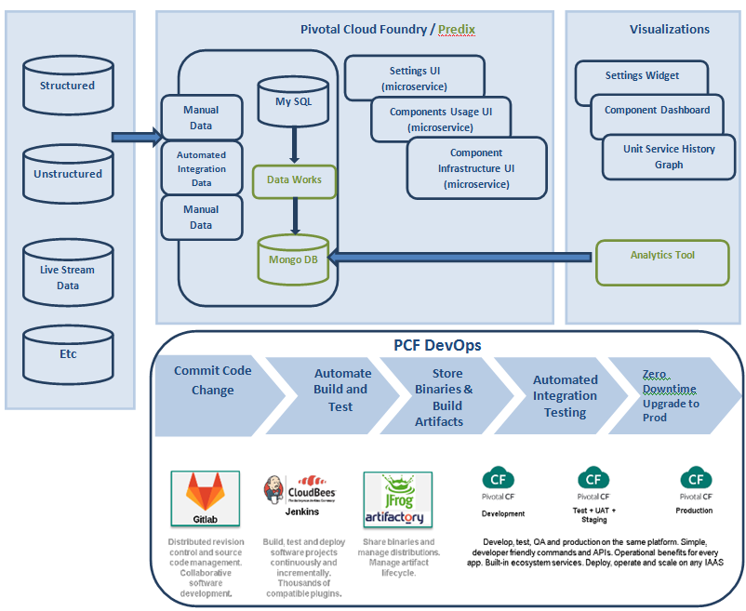
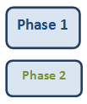
Aviation Cloud native Solution - Architecture

Slide 4
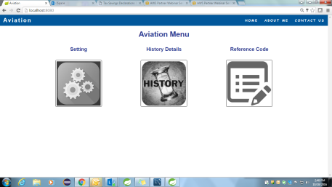
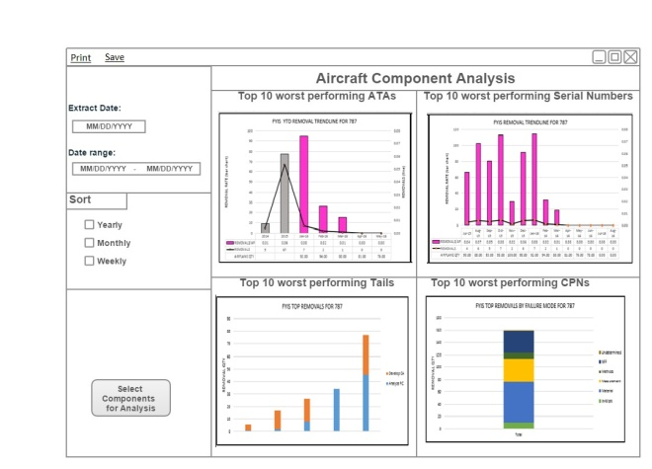
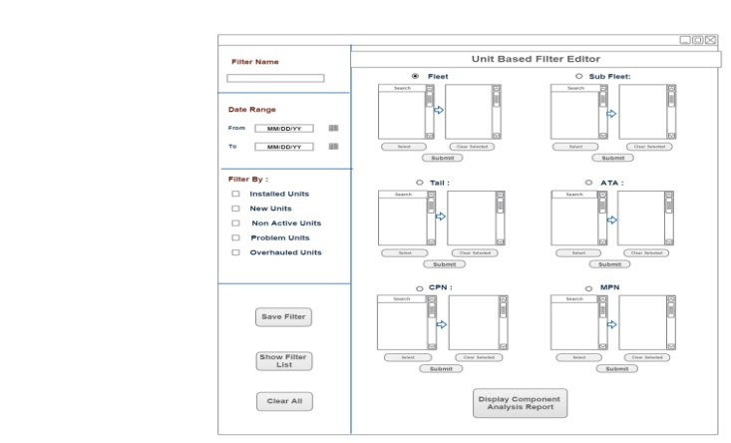
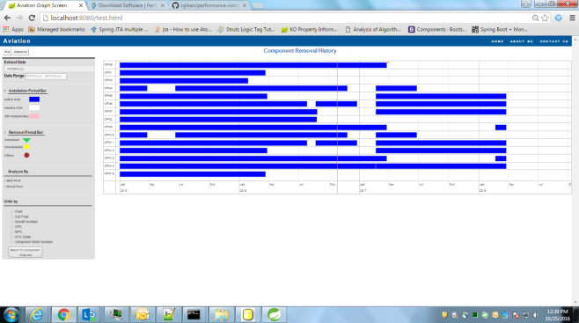
Application UI Navigation Workflow
Aviation Prototype
Navigation Workflow
UI Navigations :
User will be able to login with the credentials and land on “Aircraft Component Analysis UI” (Splash Screen), for top 10 worst performing components based on the number of removals and flight hours.
From splash screen, user can navigate to “Component Historical Analysis UI” for detail information on removal events of components such as removal reason, removal/installation date, etc.
User can navigate to “Unit Based Filter Editor UI” to select the components for which the historical analysis for removal events is required. After selecting the components user navigates to “Component Historical Analysis UI” to see the analysis in graphical format.
Login Screen
Shows analysis for the components based on date range only
Navigate to Filter editor screen if user wants to select the components for the analysis on splash screen
Aircraft component Analysis screen (Splash Screen)
Drill down for further analysis from any of the graphs in splash screen or from filter editor screen
Filter Editor Screen(To select the components for analysis)
Drill down analysis based on selection in splash screen and in Filter editor screen

Slide 5
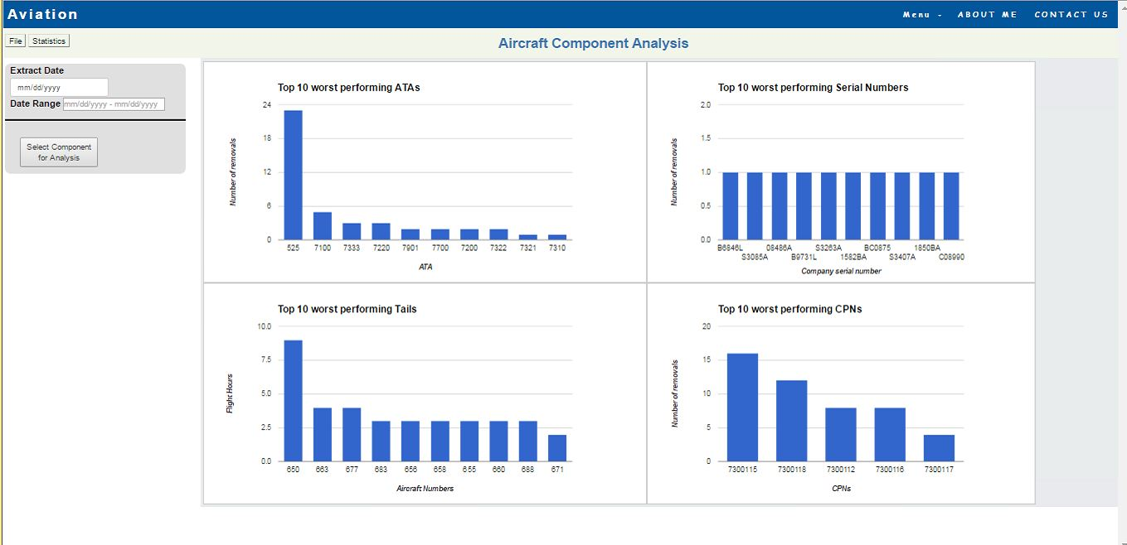
Aircraft Component Analysis UI (Splash Screen)
Aircraft Component Analysis UI :
User will land on this UI after login to the application.
This UI will display top 10 worst performing components in terms of ATA, Company Serial Numbers, Tails(ACNs) and Company part Numbers using number of removals performed on the components and number of flight hours within last 30 days from current date.
From any of the four graphs on the UI, user can ask for drilled down analysis of the displayed ATAs, CPNs, Company Sr. numbers and Tails. This will navigate user to “Component historical Analysis” UI.

Slide 6
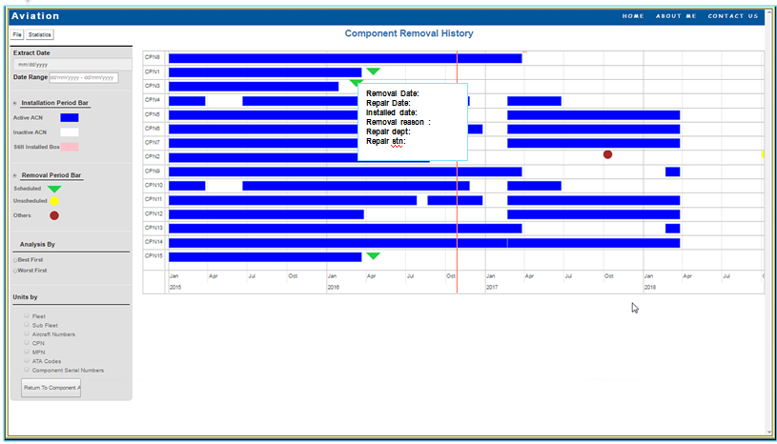
Component Removal History UI
Component Removal History UI :
User will land on this UI either from Splash Screen or from Filter Editor Screen” for analysis of selected components’ removal events in the history.
Blue bars on the graphs indicate the duration for which the component has been in installed state on the aircraft while the spaces where blue bar breaks is when the component was removed from the aircraft.
User can also see the details of all the removals performed on the component historically in the pop up screen such as: Installation and removal date, reason for removal, repair type, Installation/removal/repair location etc.

Slide 7
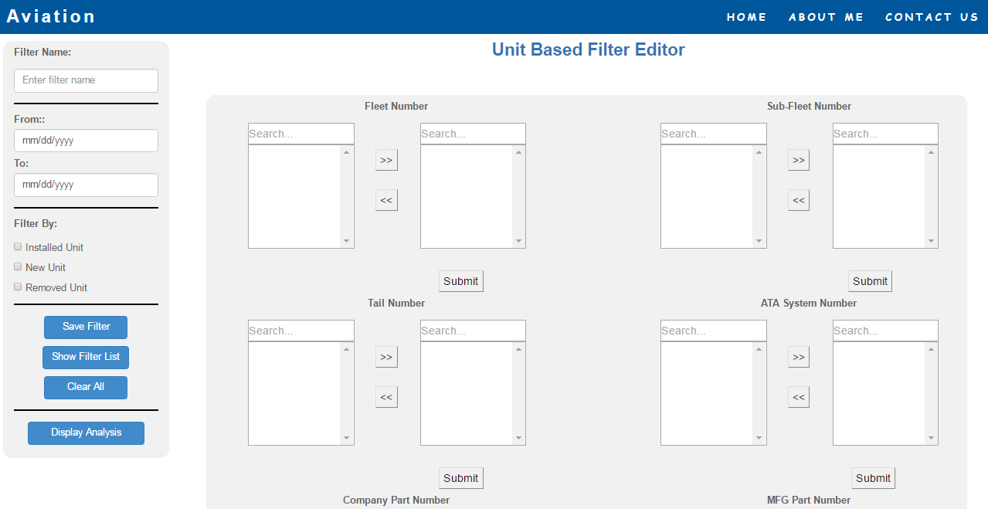
Unit Based Filter Editor Screen
Unit Based Filter Editor UI
User will land on this UI from splash screen if particular components are to be selected from the database for analysis of removal history.
User can select the component based on the attributes such as Fleet, Sub Fleet, Tail, ATA, CPN,MPN etc.and navigate to “Component Removal History” screen.
User can also save the setting done for selecting the components or use earlier saved settings to select the components for historical analysis.

Slide 8







Benefits of the Cloud Foundry Solution
Developer
Facilitate use of micro-services; availability of common services (Rabbit MQ, MySQL, HADOOP)
Enables containerization of services/applications
Choice & support multi - application languages, runtimes, frameworks at service level
Friction-free builds & deployments…almost NoOps
Platform and infrastructure transparency
Boost IT Agility
DevOps
Enable continuous integration and delivery by further leveraging CloudBees Jenkins with PCF
Integrate continuous testing…more shift right
Support of may DevOps tools: Puppet, Chef, Github, Maven, Gradle
Control
More Built-In,
Self-Service
Operator
Automate, automate
No planned downtime
Instant scaling of micro-services, apps, and instances
High environment consistency & reliability
Robust app health monitoring/management & real-time logging
Governed and secured

Slide 9



Key Benefits from Cloud Native approach.
Improvement in time to market
Reduction in cycle time
Improvement in Productivity
Instant Self service provisioning
Concept to code in minutes
Continuous Integration and Delivery
Automation and failure response
Self healing and recovery of apps & platform
Platform is independently upgradable from Apps (No downtime)
No undifferentiated heavy lifting (upgrade and patch)
No ad hoc automation
Push button control of entire application stack
Manage services, not servers
DEVOPS Enablement of Micro-Services, Iterative Culture in building & Deploying

